Slide 1
Reverse Engineering:
Legacy Systems
Alexander Endert

Slide 2
Overview of Reverse Engineering
A powerful method for gaining useful knowledge about a software system.
When is the new system complete?
Scaling up
  Reverse engineer the modules, then the system as a whole.

Slide 3
Modularization
Breaking a large, complex system into modules is essential.
Modules are grouped according to functionality.
A module’s characteristics include:
  Low Coupling
  High Cohesion

Slide 4
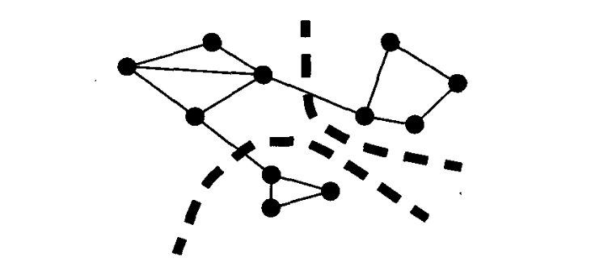
Call Graphs
A visual representation of a system.
  Nodes/Vertices represent functions.
  Edges represent invocations.

Slide 5
K-Cut Method using Call Graphs
Breaking apart a call graph to group together functions that exhibit the modular characteristics.
  High Cohesion
  Low Coupling
Difficulty arises in determining the minimal “cuts” to divide the original graph.

Slide 6
Adequacy
Two metrics to measure adequacy:
  Completeness
  Accuracy
The use of tool suites automates both the testing and the code generation.
  Example: Specware
    A toolkit for developing software strictly from specifications.

Slide 7
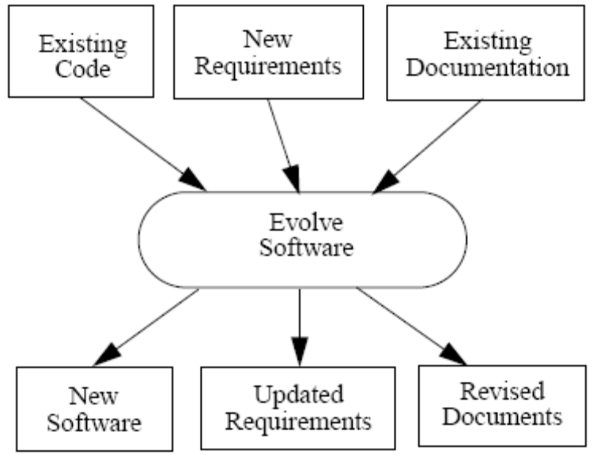
Testing
Must test and update not only code, but requirements and documentation as well.
Commonly used method: MORALE
  Mission Oriented Architectural Legacy Evolution
  Uses existing inputs and results in order to generate the new system.

Slide 8
Ethical Implications
RE is a very powerful tool.
An engineer must have the proper permission to gain the information.
Cracking a software system by reverse engineering gives the discipline a bad reputation.

Slide 9
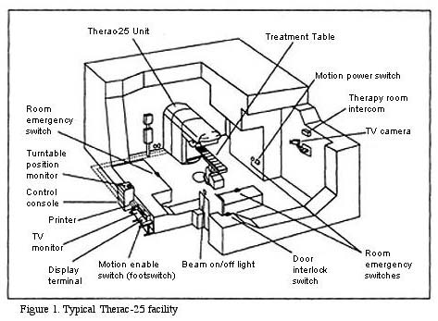
Examples of Badly Engineered Legacy Systems
Therac-25
  Badly documented software.
  Poor error messages.
  Lack of customer support.

Slide 10
Q & A

